Slide 1
AIPLIRS Un-edited presentation
Jufrey Niño E. Bayog
John Paul S. Bobila
Systems Development
PIMD-ICT

Slide 2
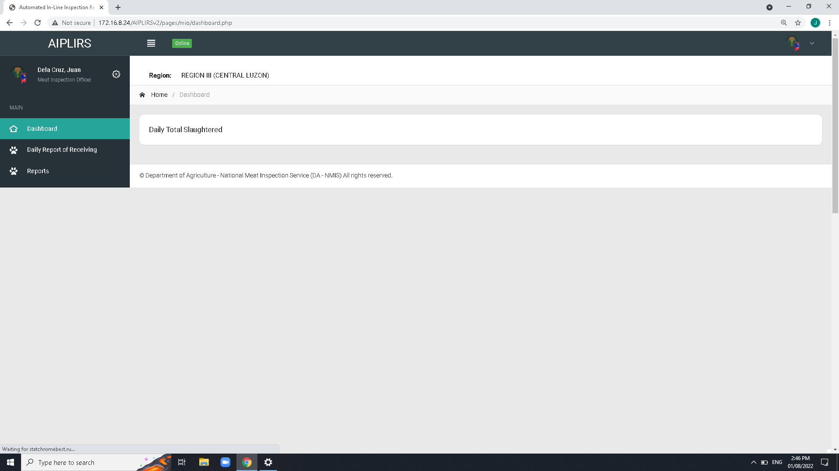
Create a summary card for the receiving, fit for slaughter, fit for human consumption
Remove Navigation bar header and breadcrumbs on all pages
To be added on MIO account sidebar:
Output is the summary on the all Meat establishment assignment base on dates
(suggestions: tick boxes for the Current, previous)

Slide 3
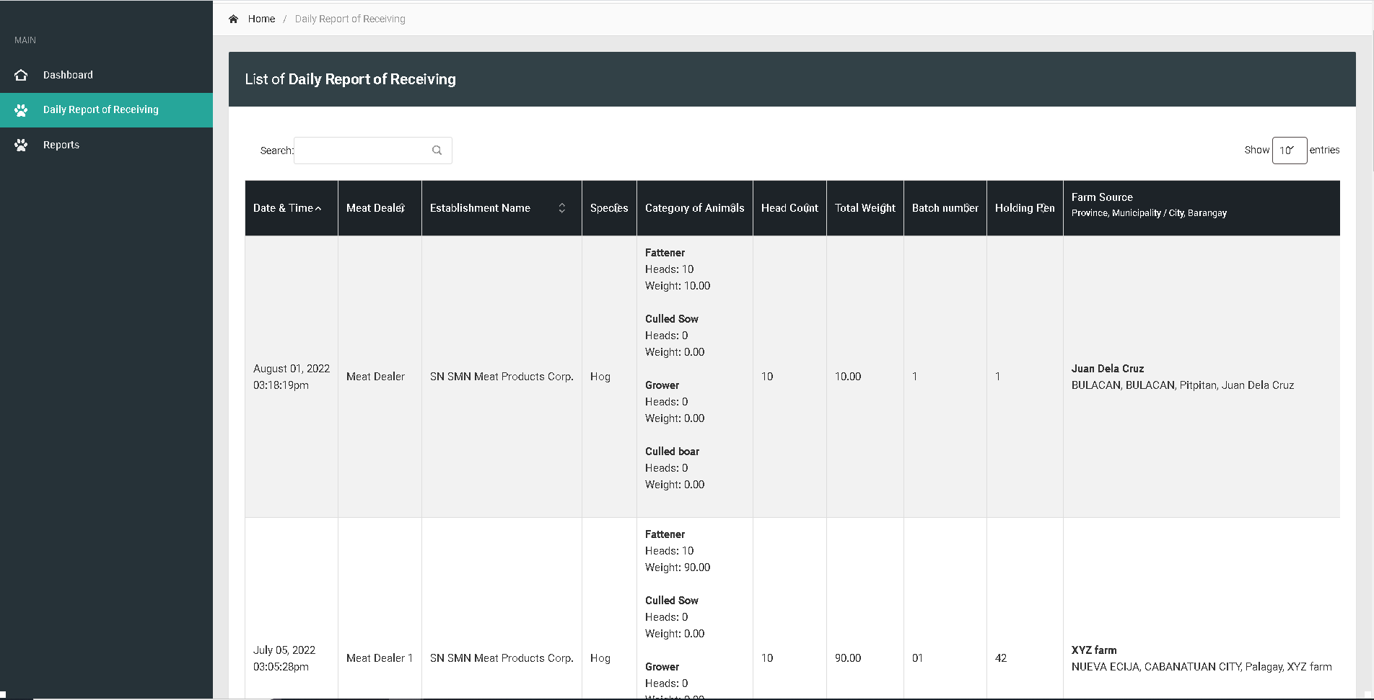
Change sidebar title to Daily Receiving of Animals
Change title to Daily Receiving of Animals
Batch and holding pen : Text align center
For the column of head count and total weight make it text right
Change header title
Establishment to Meat establishment
Total weight to total weight(kg)
Change table header
Farm Source and Address
Remove indicator
Remove on fetch data of line code
Change address format to “barangay, city, province”

Slide 4
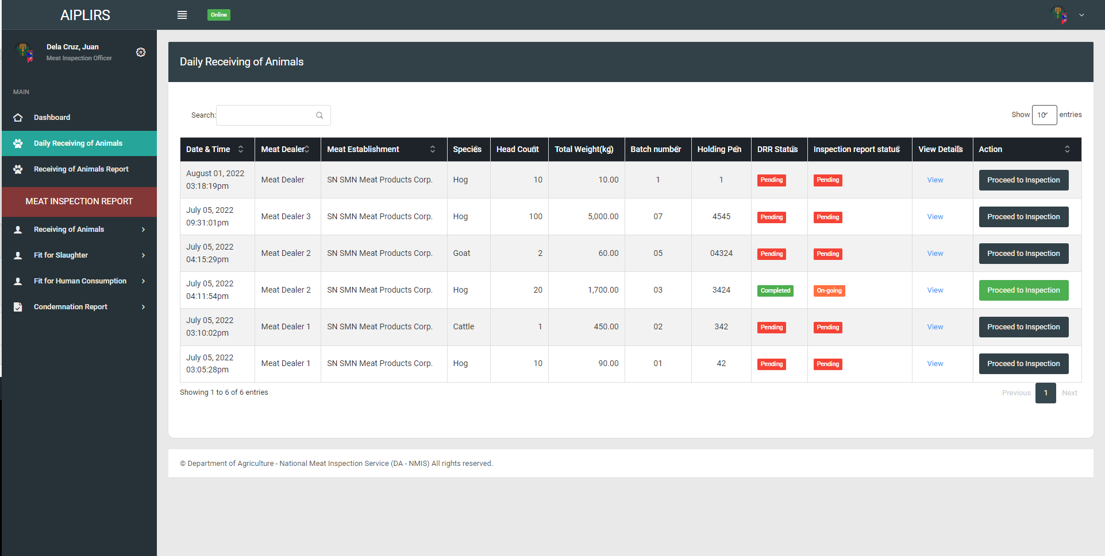
DRR status: pending (request to edit), Completed,
Details of DRR page action: proceed to inspection(DRR status will update to approved), request to edit
Inspection report status: Pending(upon checking Drr page), On-going(if DRR is approved color: orange), completed(Antemortem & postmortem conducted)
View Details to View DRR
Remove action column meat dealer, total weight, batch numer, holding pen
Change positioning of after head count change header “drr details” button “td” view
Order of the table after drr details “DRR STATUS”, “INSPECTION STATUS”

